Slide 1
Oil change
Pgss auto 11/12

Slide 2
Safety safety safety
No watches
No rings
No dangly things
No hoodie strings
Safety goggles
safety goggles
safety goggles

Slide 3
Equipment needed
3/8 drive ratchet
3/8 drive socket. The right size to fit the drain plug on oil pan
Oil filter wrench or socket to fit the vehicles oil filter
Trouble light
Drain bucket
funnel

Slide 4
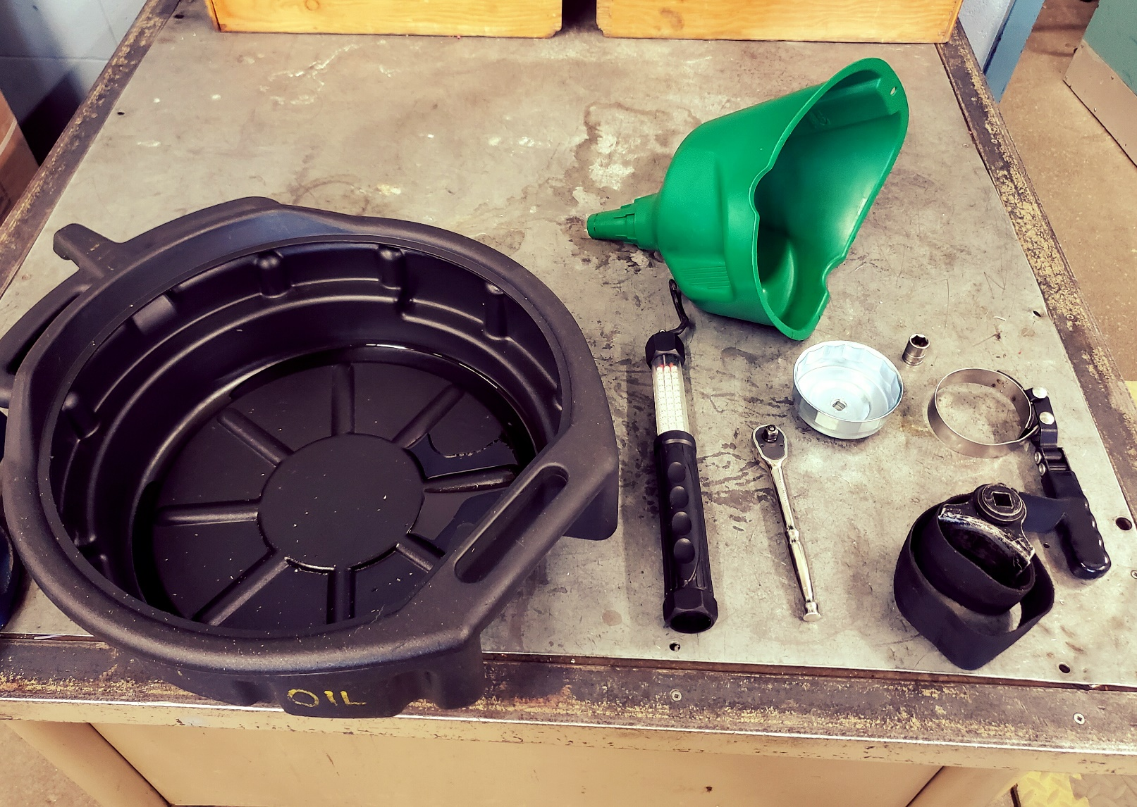
Equipment Needed

Slide 5
Vehicle information needed
YEAR
MAKE
MODEL
ENGINE SIZE
OF THE VECHILE YOU ARE WORKING ON

Slide 6
Parts needed
ENGINE OIL
ENGINE OIL FILTER
CONTACT A PARTS SUPPLIER WITH THE VEHICLE INFORMATION YOU OBTAINED IN THE PREVIOUS SLIDE
THIS WILL ENSURE YOU GET THE CORRECT TYPE AND AMOUNT OF ENGINE OIL AND THE CORRECT ENGINE OIL FILTER FOR YOUR VEHICLE

Slide 7
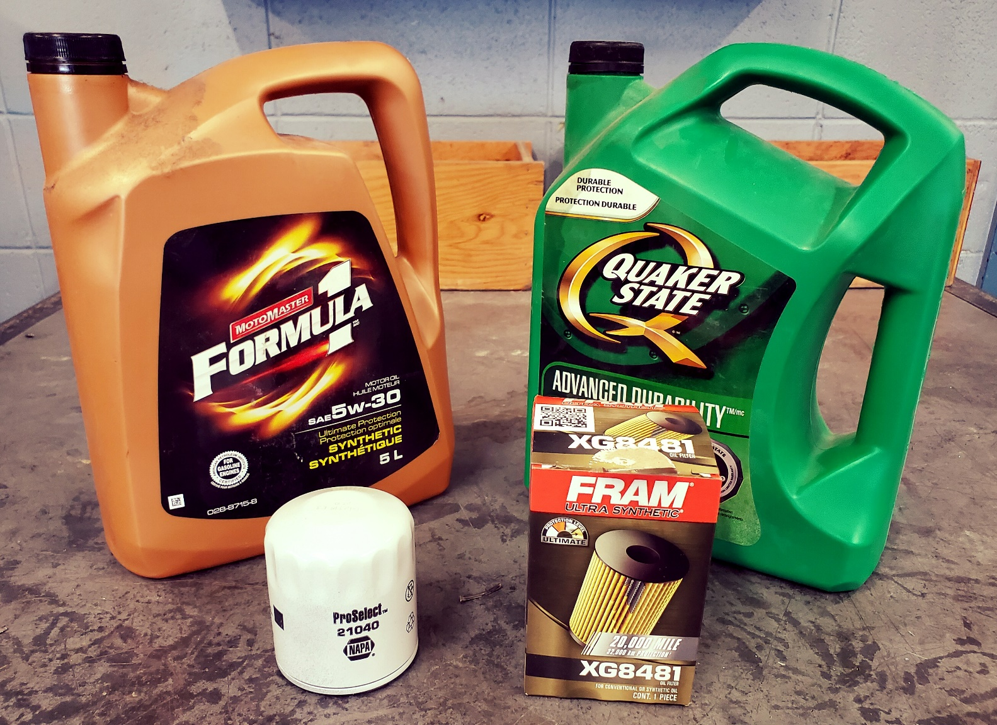
PARTS NEEDED

Slide 8
Procedure ALL RIGHT LET’S GET STARTED

Slide 9
Step 1 bring the car up to operating temperature THIS WILL ENSURE THAT ALL Contaminants WILL BE STIRRED UP AND TRAPPED IN THE OIL ONCE VEHICLE IS UP TO TEMP SHUT OFF AT THIS POINT ENGINE OIL AND ALL PARTS WILL BE EXTREMLY HOT ! USE SAFETY GOGGLES AND CAUTION AT ALL TIMES

Slide 10
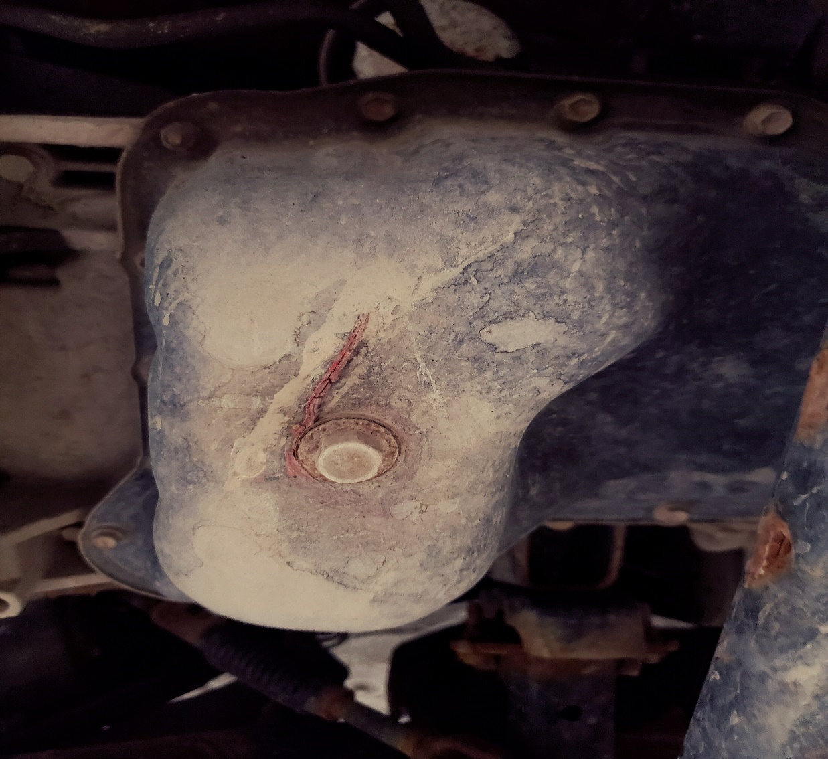
Step 2 LOCATE OIL PAN AND DRAIN PLUG ON THE UNDERSIDE OF THE ENGINE

Slide 11
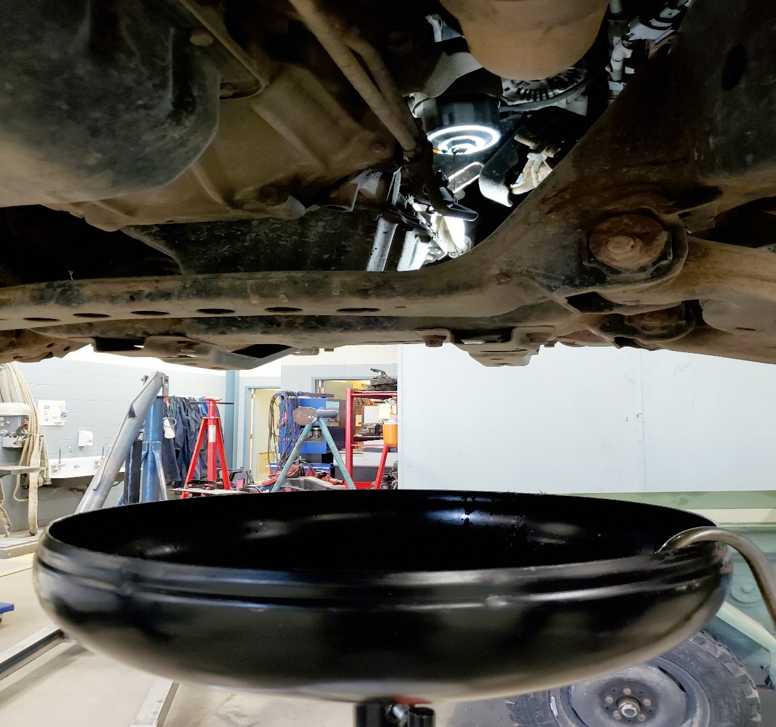
STEP 3 PLACE drain bucket under oil pan loosen drain plug ratchet and socket should be turned counter clockwise
PLAY ME!

Slide 12
Step 4 remove drain plug CAUTION REMEMBER THE OIL IS EXTREMLY HOT
PLAY ME !

Slide 13
Step 5 drain oil
Play Me!

Slide 14
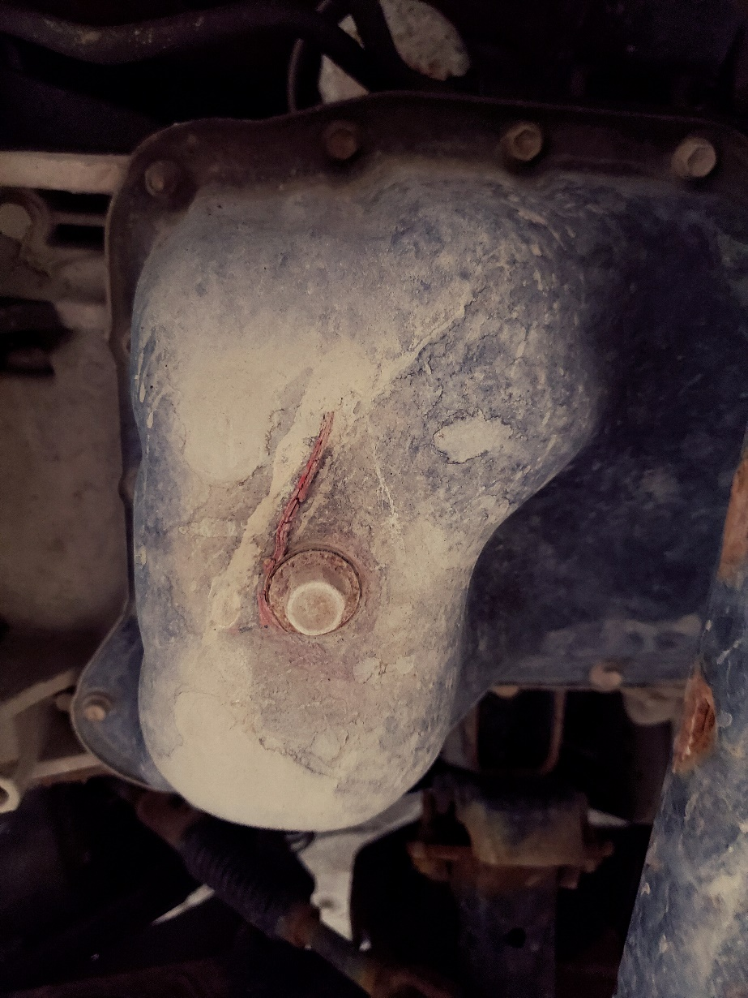
Step 6 clean and reinstall drain plug

Slide 15
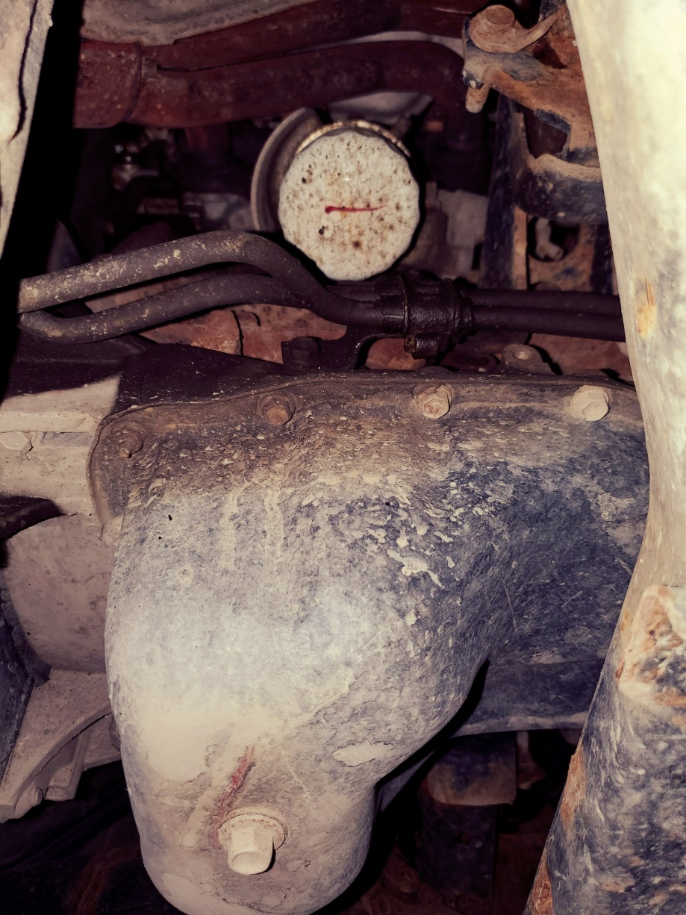
Step 7 remove oil filter use an oil filter socket or wrench
PLAY ME

Slide 16
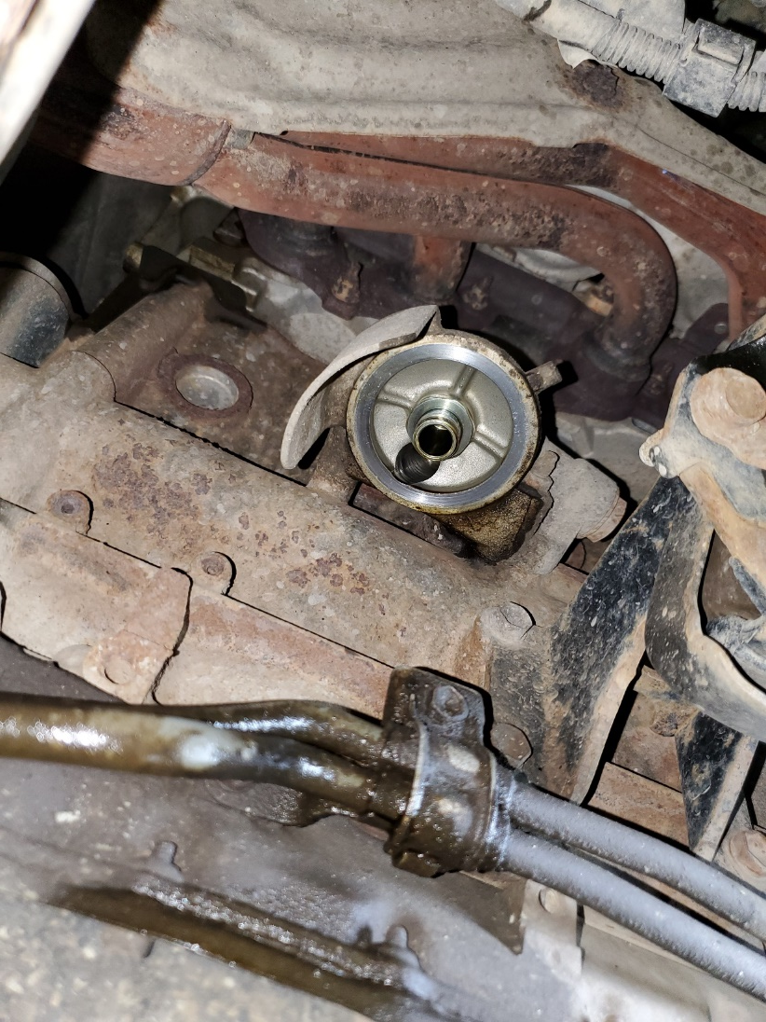
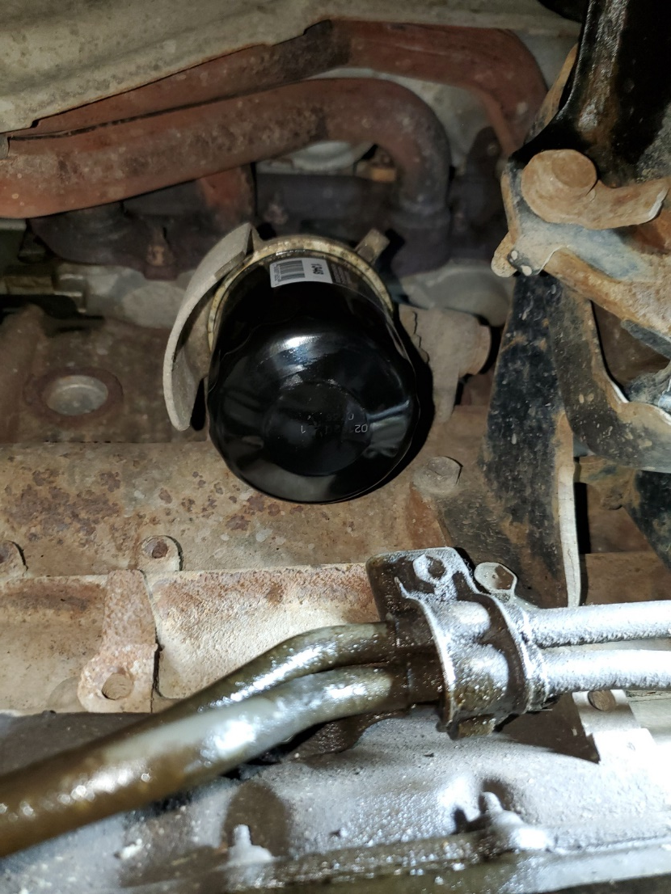
Step 8 install new oil filter be sure to lube the rubber seal on the new filter install the filter hand tight only

Slide 17
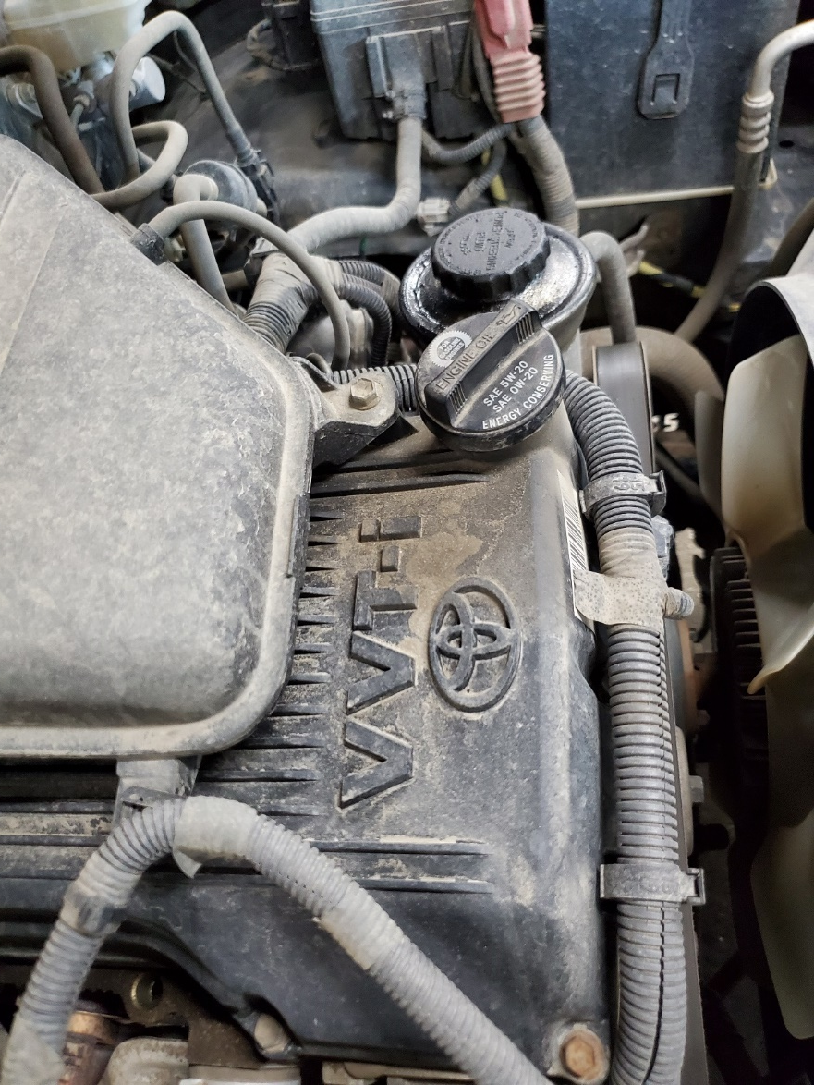
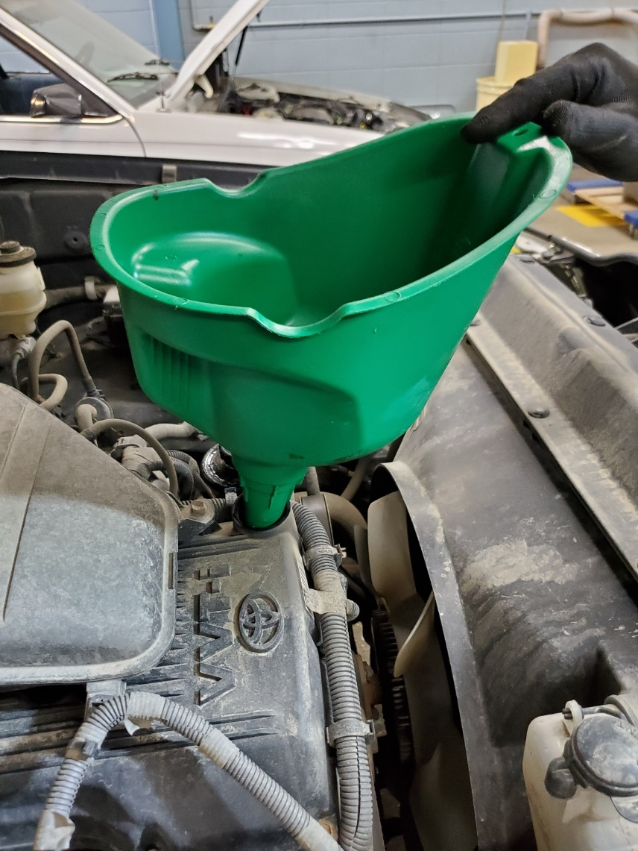
Step 9 add the correct TYPE AND amount of new oil
PLAY ME !

Slide 18
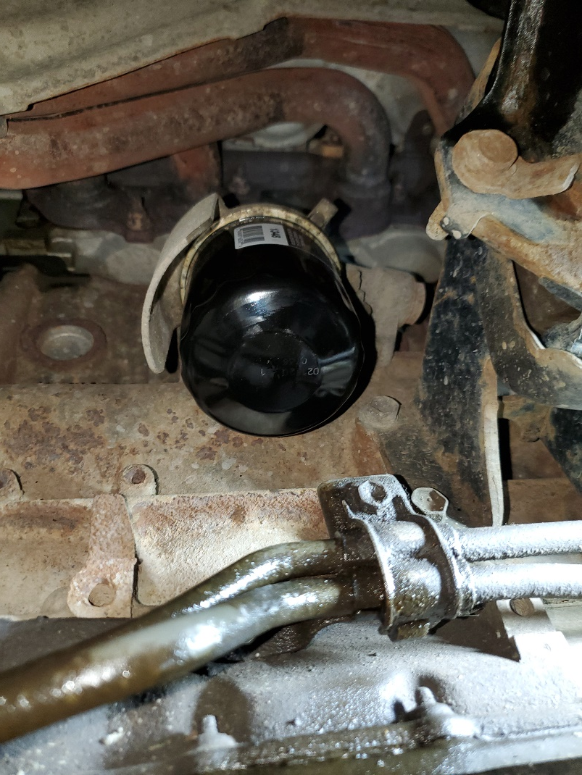
Step 10 start vehicle and check for oil leaks look around the drain plug and filter

Slide 19
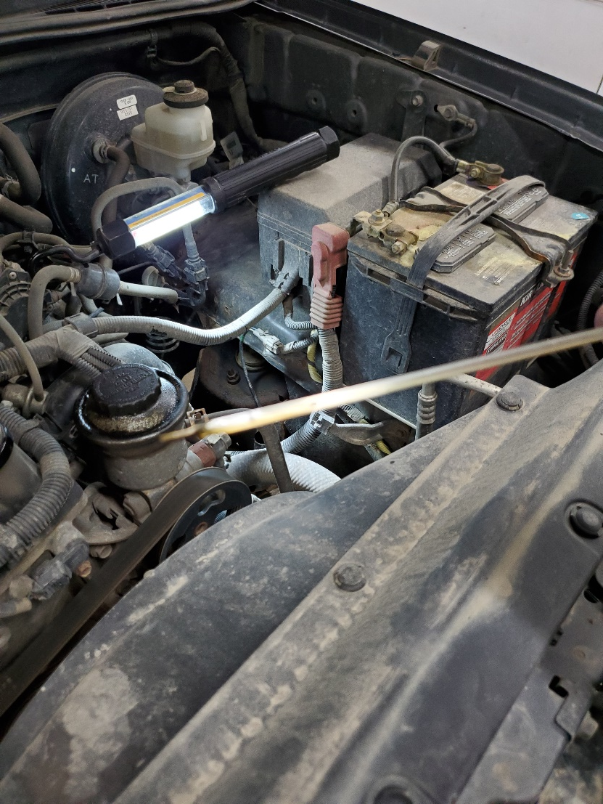
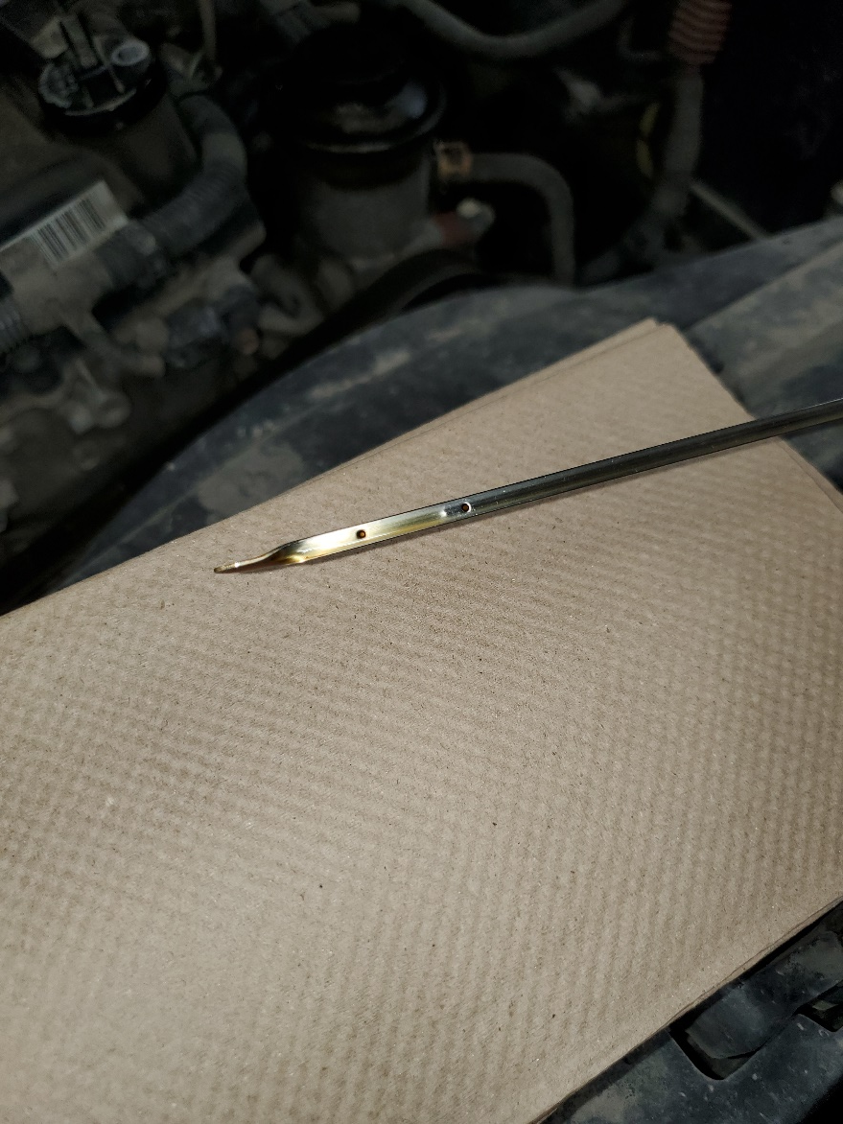
Step 11 shut off vehicle and wait a minute or two check oil level with engine off adjust as necessary

Slide 20
Step 12 clean up your area dispose of old oil and filter at a proper waste facility recycle oil containers if possible record and submit your results to mr g WELL DONE !

