Slide 1
Air filter inspection
Pgss automotive 11/12

Slide 2
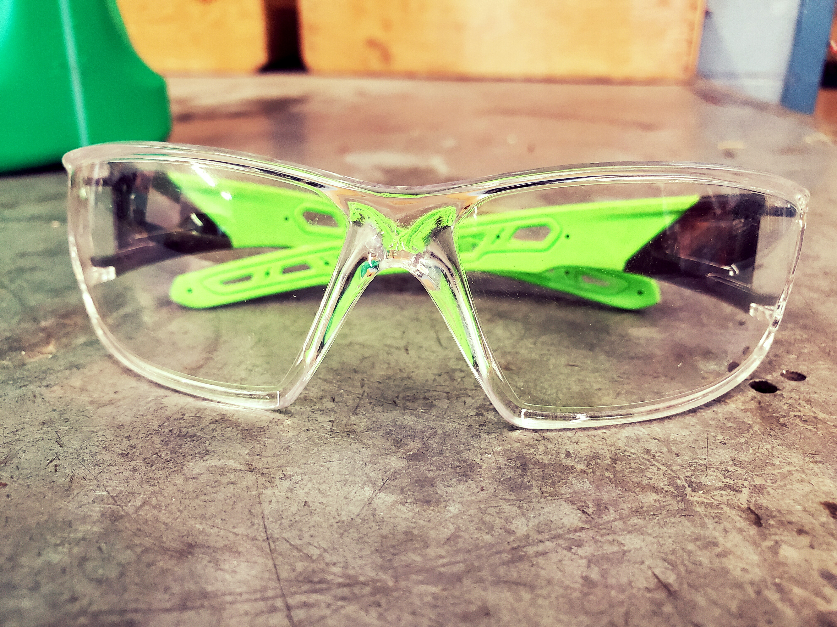
Equipment needed
Safety goggles
Trouble light
shop towel or rag

Slide 3
Locate the air box
Raise the hood
Locate the air box
Usually a big black square or rectangle
Remove or disconnect hold down clips or screws

Slide 4
Disconnect hold down clips

Slide 5
Remove air filter
Carefully note the position of the filter
Right side up / upside down
Take a photo if necessary this will help with a reinstall

Slide 6
The air filter revealed

Slide 7
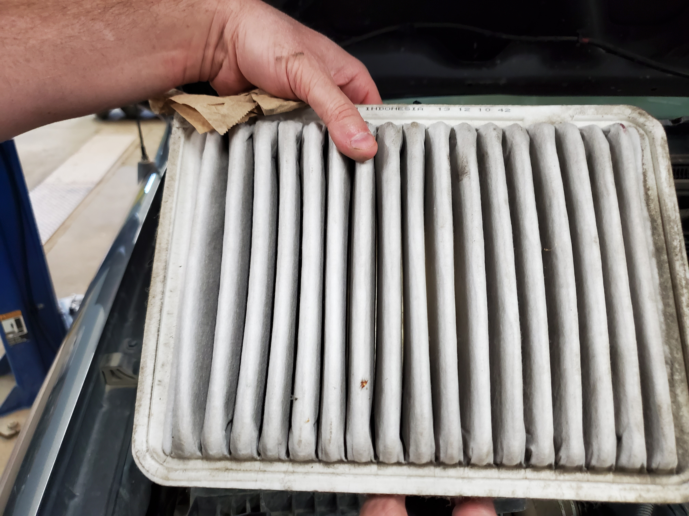
Carefully remove the filter

Slide 8
Checking the air filter with a trouble light

Slide 9
Does the filter pass or fail?
Shine a light behind the filter
Can you see lots of light through it
Pass
If little or no light passes through
Fail
What are your results?

Slide 10
Tap out the filter on the floor or bench
Press play
Recheck the filter with the trouble light

Slide 11
Replace air filter as necessary
vehicle information is needed for the correct air filter replacement
year
Make
Model
Engine size
Contact a parts supplier with the information to obtain a new filter.

Slide 12
New filter

Slide 13
Reinstall air filter in proper air box location

Slide 14
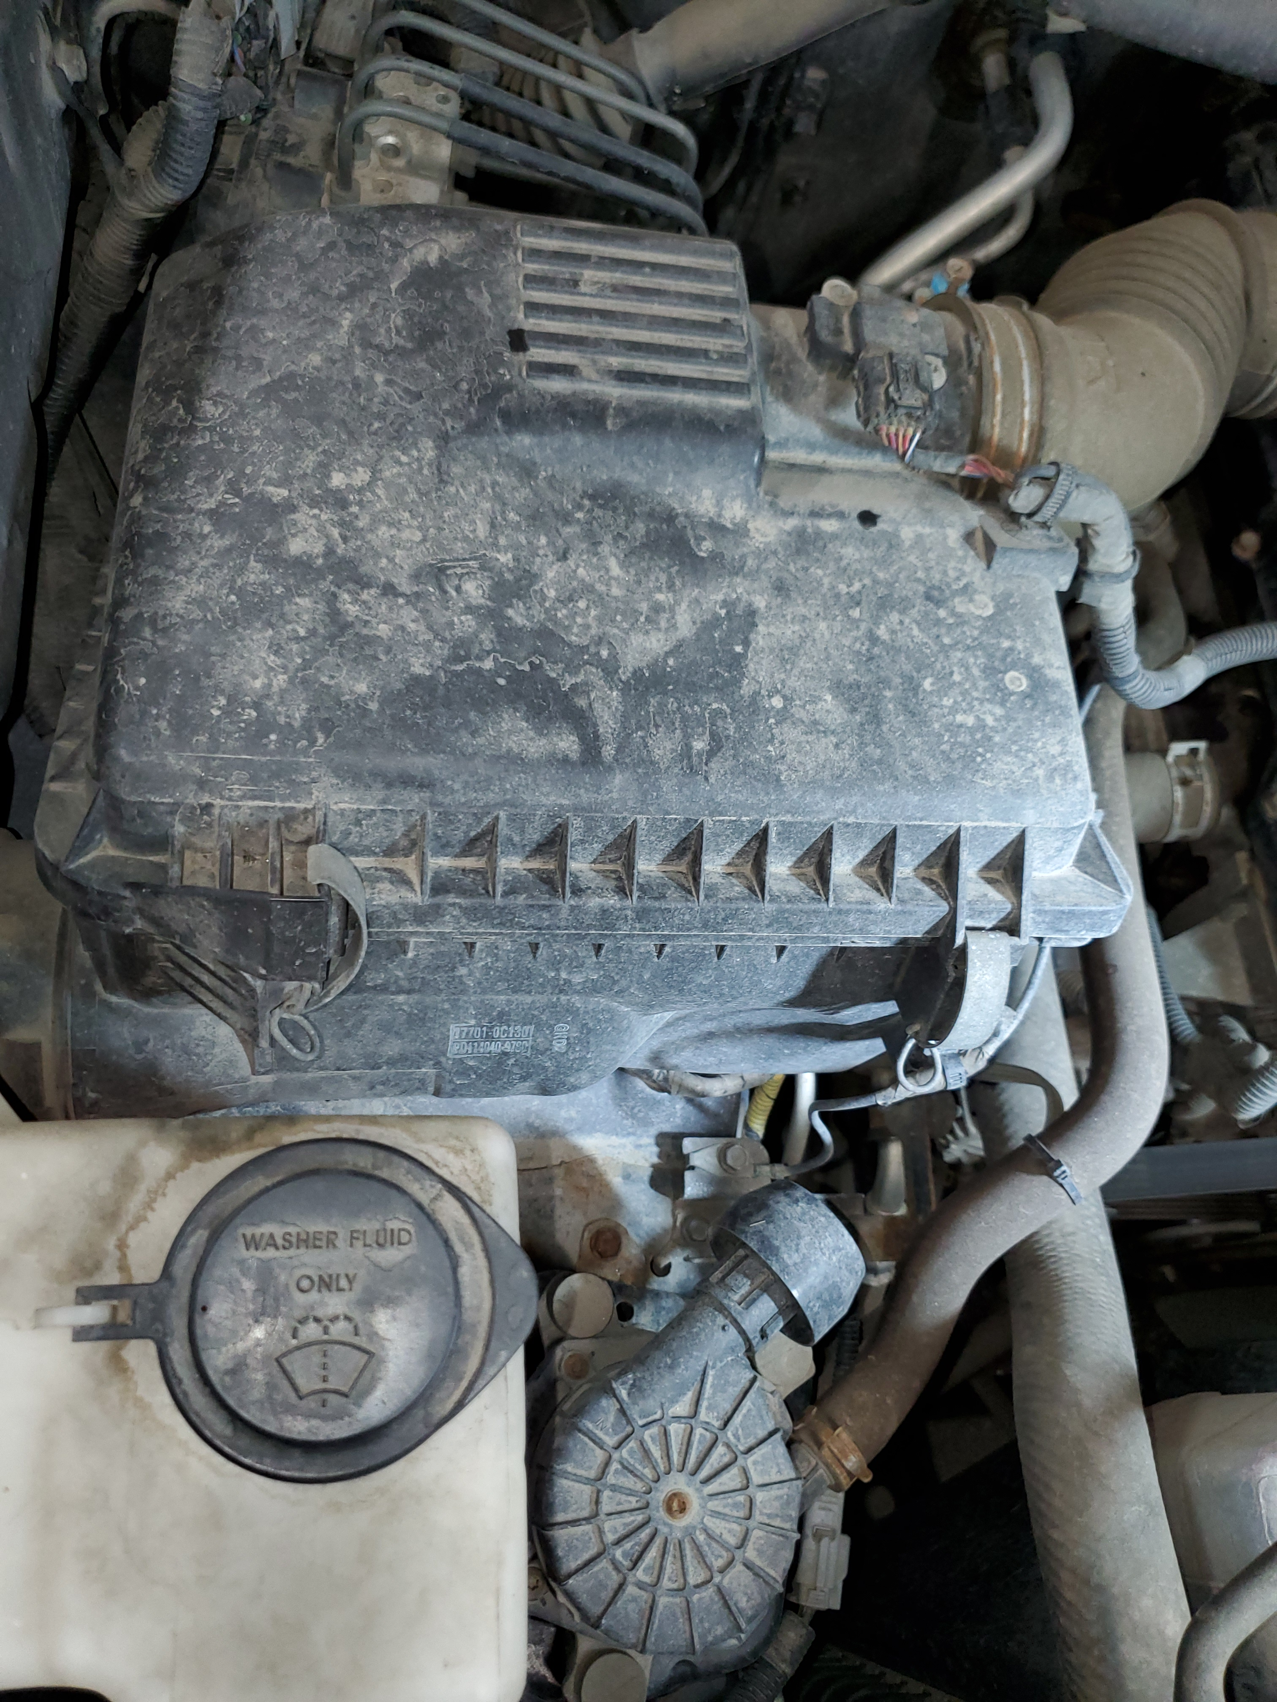
Reinstall air box lid
Check the fit of the lid
Secure the latches
You’re good to go

Slide 15
Submit results to Mr. G

